Slide 1
Chapter 5 Principles of Voice Leading
MUS 112
February 13-15, 2017

Slide 2
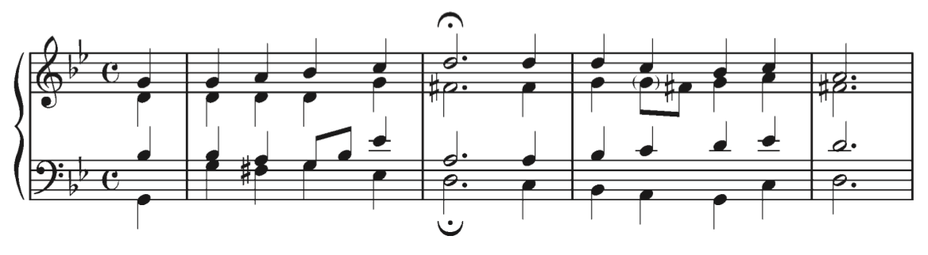

Slide 3
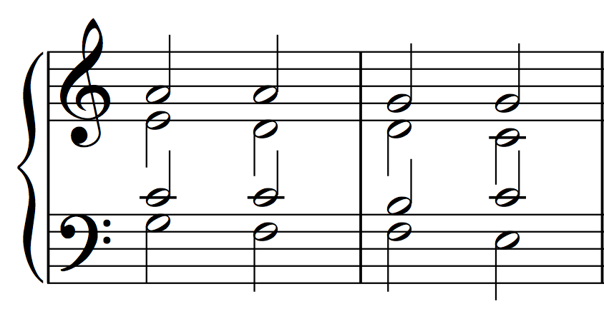
Introduction
We have looked at most of the chords you will see in tonal music.
Harmonic Progression: A series of chords
Voice Leading: The way in which chords in a harmonic progression connect
Part Writing: Voice-leading of several individual musical lines, that result in chords when the lines are combined.
When notating multiple parts or voices on a single staff, it is necessary to have the stems of the top part point up and the the stems of the bottom part point down
soprano
alto
tenor
bass

Slide 4
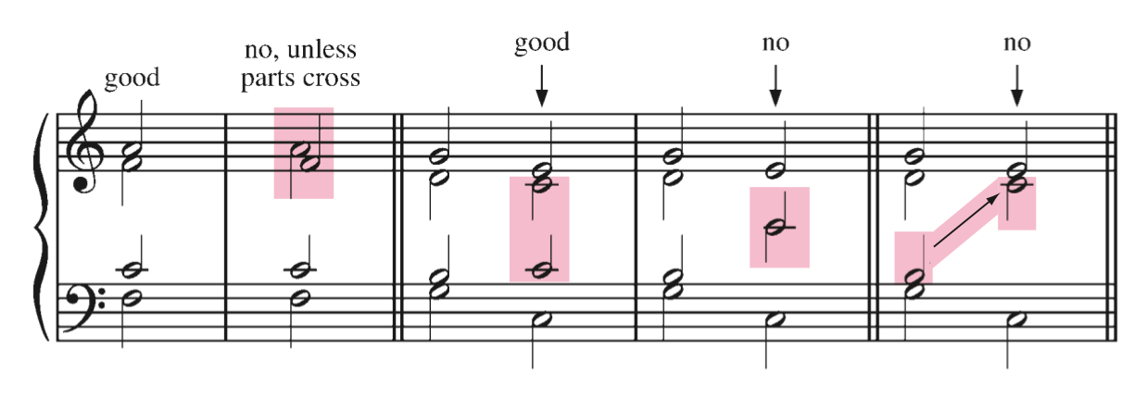
Notating Chords

Slide 5
Where we are headed………
We are beginning on our journey of mastering chorale writing.
Goal: Three and four voice chorales that include any chord/inversion you choose, modulate to other keys, mix the major and minor modes, and chromatically embellish melodies.
Why?
By developing all of theses skills you master the intricacies of tonal harmony
Doing so will allow you to:
Have more flexibility as a composer.
Have more understanding as a listening.
Make more informed musical decisions as a performer.
Chorale writing provides us an ideal tool to develop these skills

Slide 6
The Melodic Line
The fundamental element of chorale writing is the melodic line.
Chorales are built by layering melodies on top of one another.
Let’s begin by developing the ability to write simple melodic lines in vocal style
A melody that easily lends itself to singing
There are five guidelines to follow to compose a melody in vocal style.
Rhythm, Harmony, Contour, Leaps, Tendency Tones

Slide 7
Guidelines for Composing a Melodic Line
Rhythm
Keep the rhythm simple, with most durations being equal to or longer than the duration of the beat.
The initial note should occur on a strong beat.
Harmony
Every melody note should belong to the chord that is to harmonize it.
Contour
The melody should be primarily conjunct(stepwise).
The shape of the melody should be interesting but clear and simple, with a single focal point, the highest note of the melody.

Slide 8
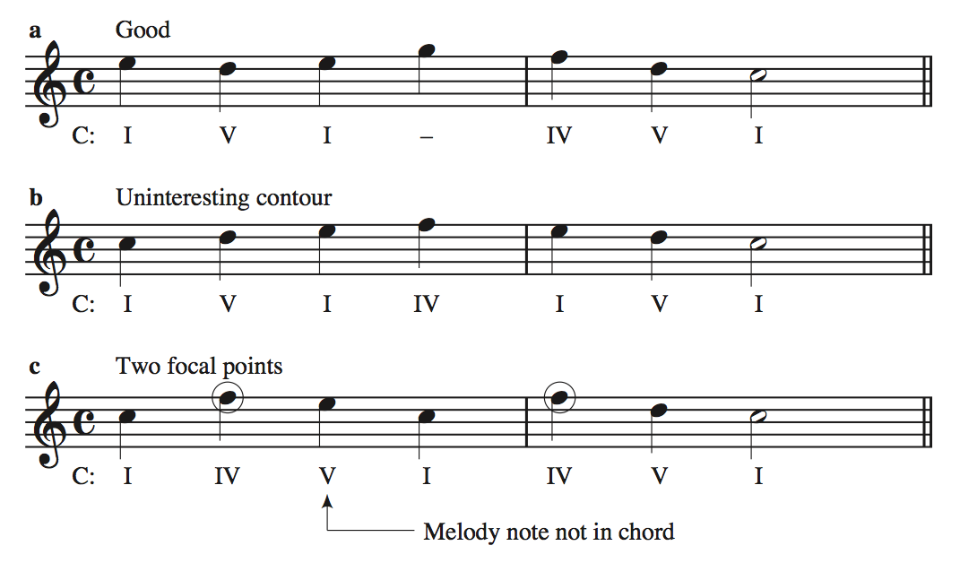

Slide 9
Guidelines for Composing a Melodic Line
Leaps
Avoid the following intervals
augmented intervals
7ths
intervals larger than a P8.
Diminished intervals may be used if the melody changes direction by step immediately after the interval.
A melodic interval larger than a P4 is usually best approached and left in the direction opposite to the leap.
When smaller leaps are used consecutively in the same direction, they should outline a triad.
Tendency tones
ˆ7 has a strong tendency to move up to ˆ1.
An exception to this is the scale wise line descending from ˆ1: ˆ1–ˆ7–ˆ6–ˆ5.
The only other tendency tone that needs to be considered is ˆ4, which often moves down to ˆ3, but not with the regularity with which ˆ7 goes to ˆ1.

Slide 10
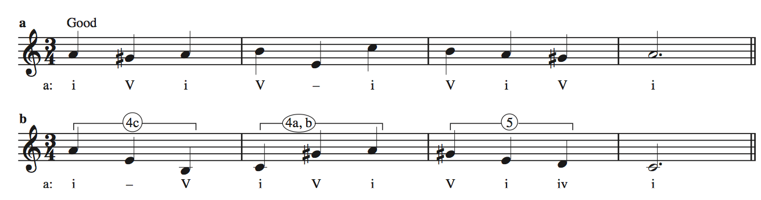
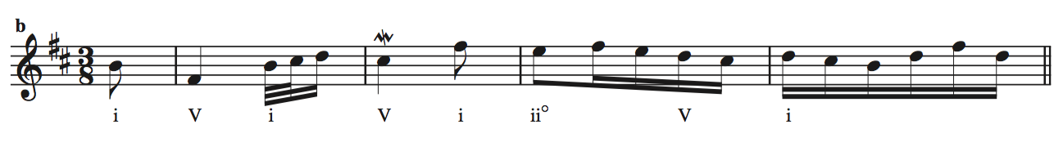
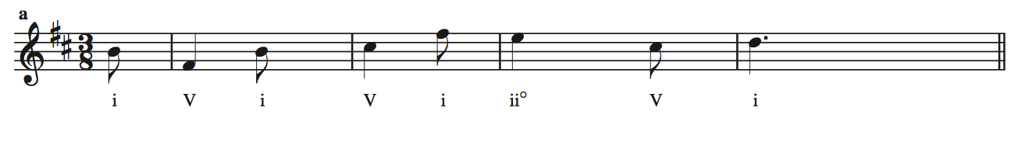
Many ornate and complicated melodies, are just elaborations of these of these guidelines.

Slide 11
Composition Assignment No. 1

Slide 12
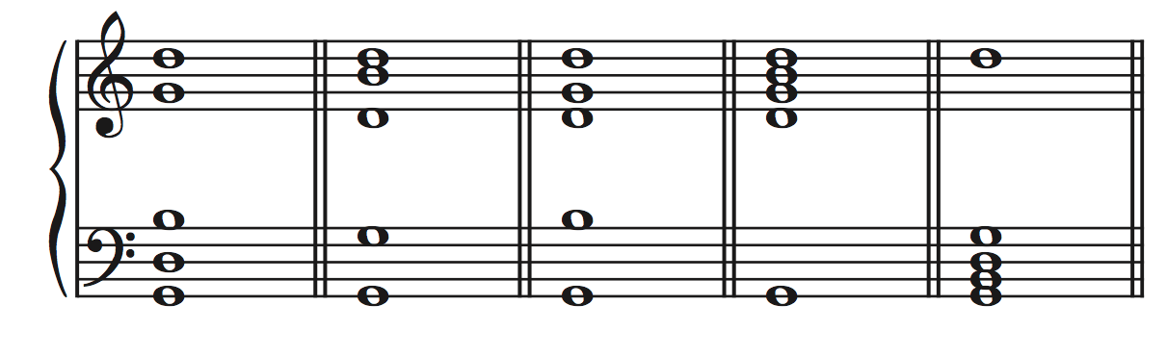
Voicing a Single Chord
Once you have decided on what chord to write, you must decide how to voice it.
Voicing: The distribution or spacing of the members in a single chord.
As you can imagine, there are innumerable possibilities for the voicing for any given chord

Slide 13
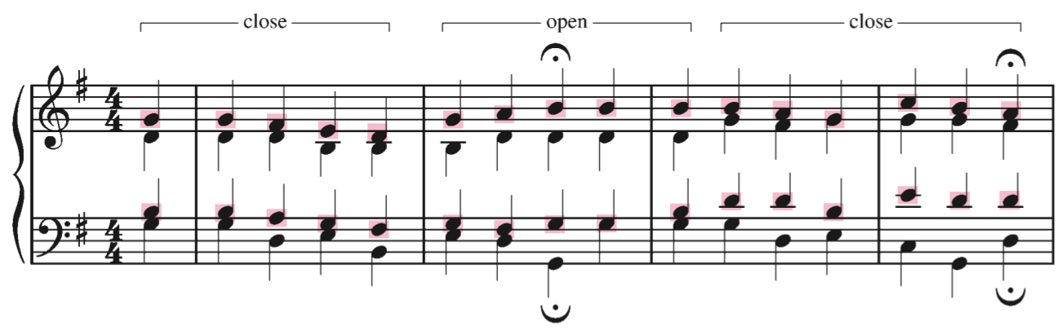
Voicing a Single Chord
There are two ways that we can describe the voicing of a chord:
Open Structure: more than an octave between the soprano and tenor voice
Closed Structure: Less than an octave between the soprano and tenor voice

Slide 14
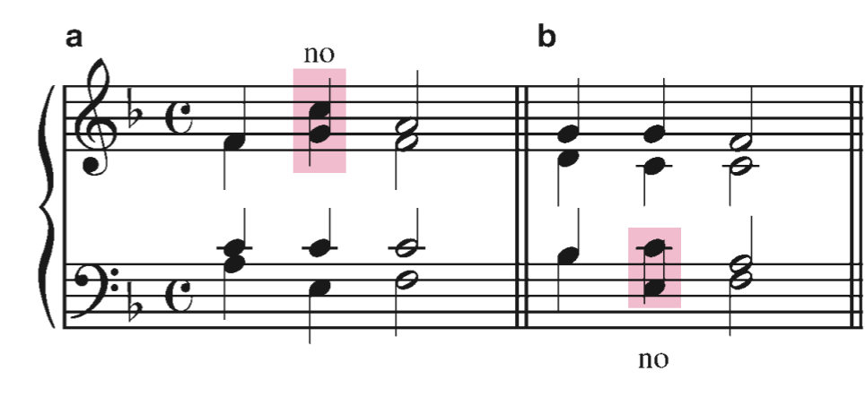
Part-writing Guidelines
Avoid Crossed Voices.
This is where a voice is higher than the voice part above it, or lower than the voice part below it.

Slide 15
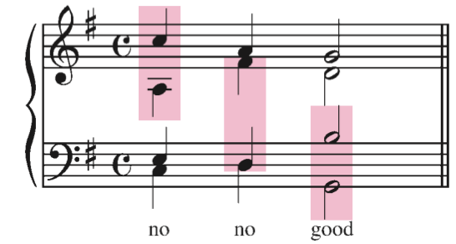
Part-writing Guidelines
Voice Spacing
Avoid overly spacious chord voicings
There should be no more than an octave between each voice, excluding between the tenor and bass.

Slide 16
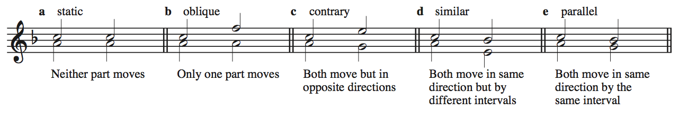
Parallel Motion
In tonal music, it is important to consider the relationships between any voice in the texture and every other voice in the texture.
When music progresses from one chord to the next, there are five possible relationships between any two voices (or parts).
In a four-part texture, there are six distinct pairs of voices, that each have their own movement type for each chord change.

Slide 17
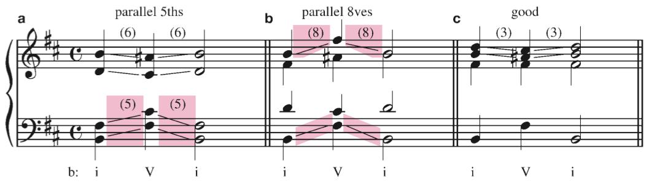
Objectionable Parallel Movement
A hallmark of this style we are learning is the independence of voices.
P5 and P8 are the most stable and pure intervals
When two voices are at an interval of a P5 or P8 and move in parallel motion the voices become linked and the independence of each voice is lost.

Slide 18
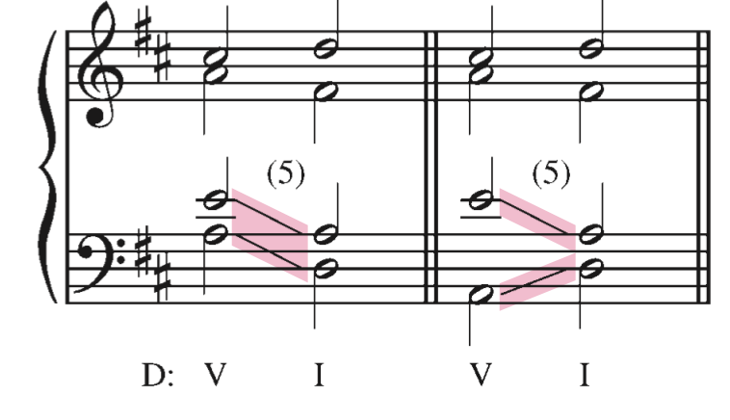
Contrary 5ths and Octaves
We also avoid contrary movement in 5ths and octaves.
These have a similar sonic effect as parallel 5ths and octaves

Slide 19
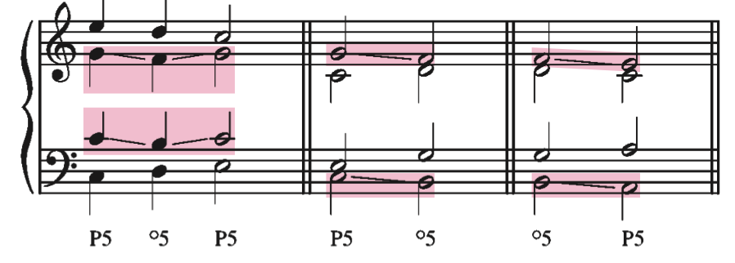
Unequal 5ths
Unequal 5ths are parallel 5ths where one of the fifths is diminished.
º5 → P5
P5 → º5
These are generally considered acceptable, unless the unequal fifth involves the bass voice and is moving from º5 → P5
Just avoid them

Slide 20
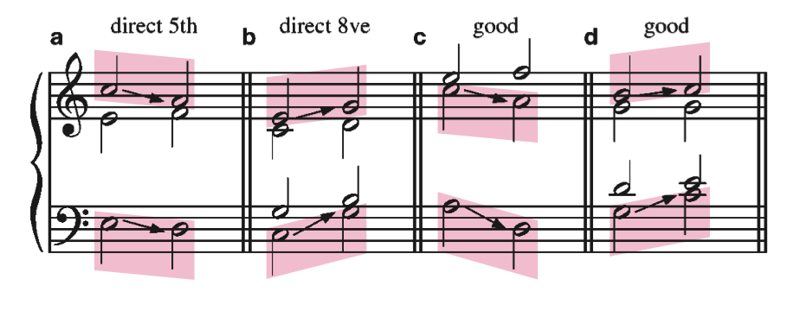
Direct Fifths and Octaves
A direct fifth or octave results when the outer voices move in the same direction and arrive on a perfect fifth or octave. The soprano part must be leaping.
This sounds very close to parallel fifths and octaves, so we avoid them.
Essentially, our ear fills in the notes that the soprano leaps over, and this creates the illusion of parallel motion.

